Slide 1
Newhaven yacht club warmly invites all members to its autumn 2024 ‘Skills forum’
New Tech, Not so tech and Boat Hacks
Venue:
White Lion hotel, 74 Claremont Rd, Seaford BN25 2BJ
Tuesday 8th October, meet at 7pm
By Matt Longbone

Slide 2
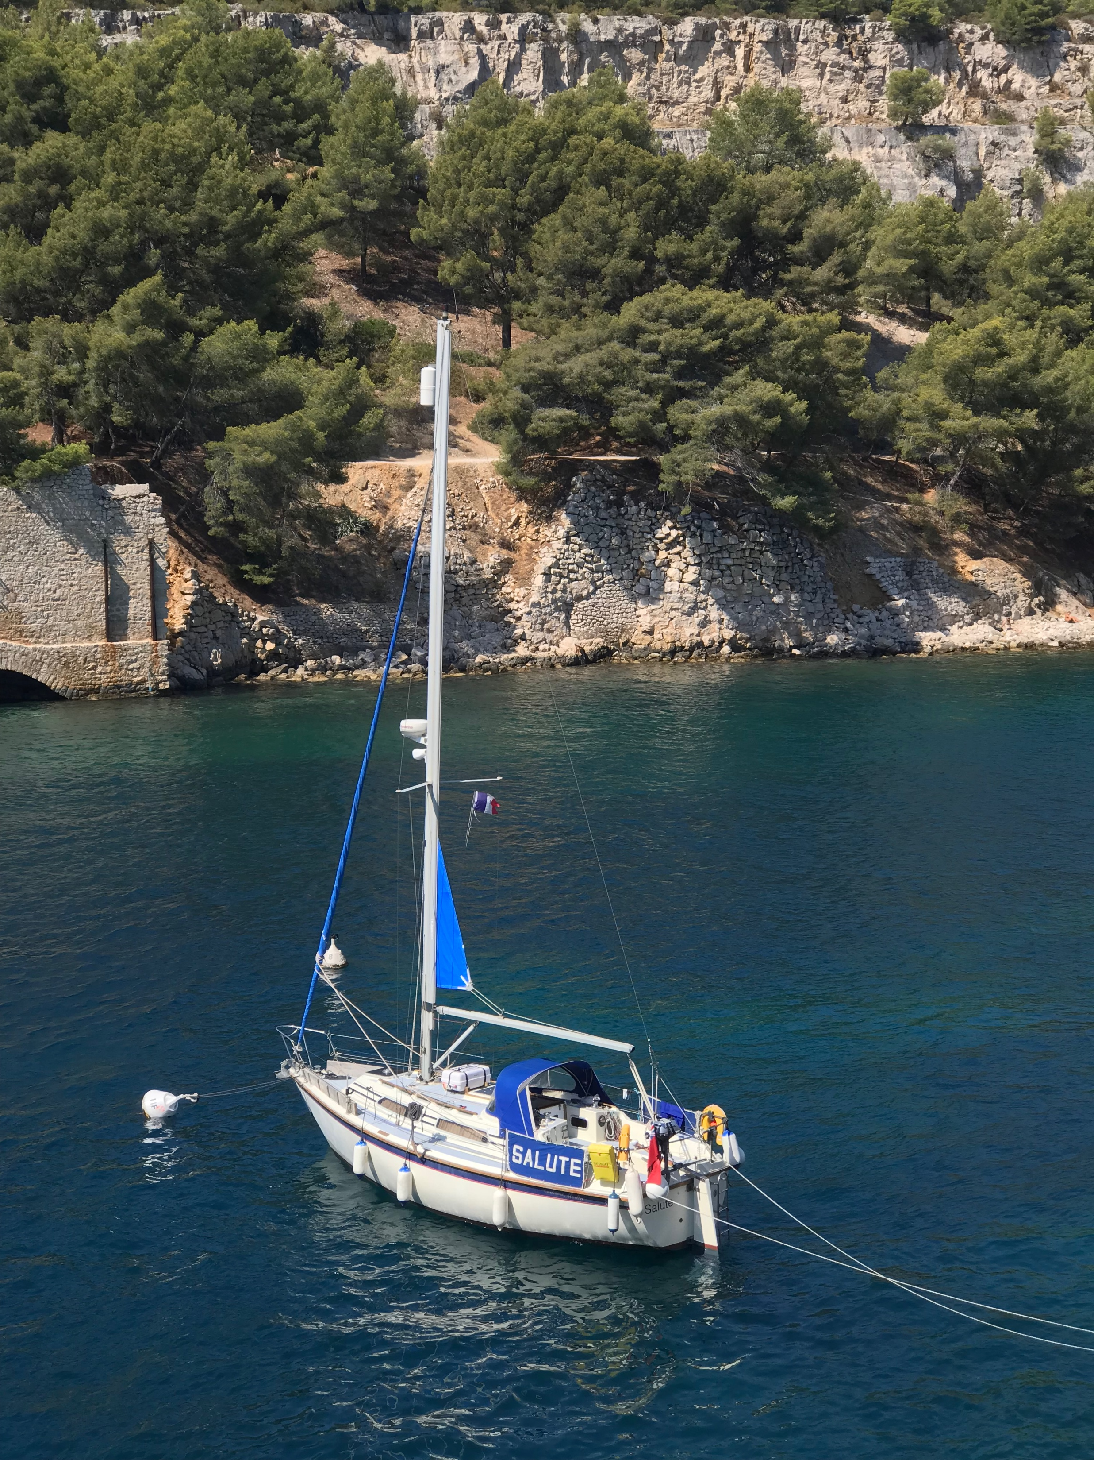
New Tech, Not so tech and Boat Hacks
Some ‘as tested’ here!...
By Matt Longbone

Slide 3
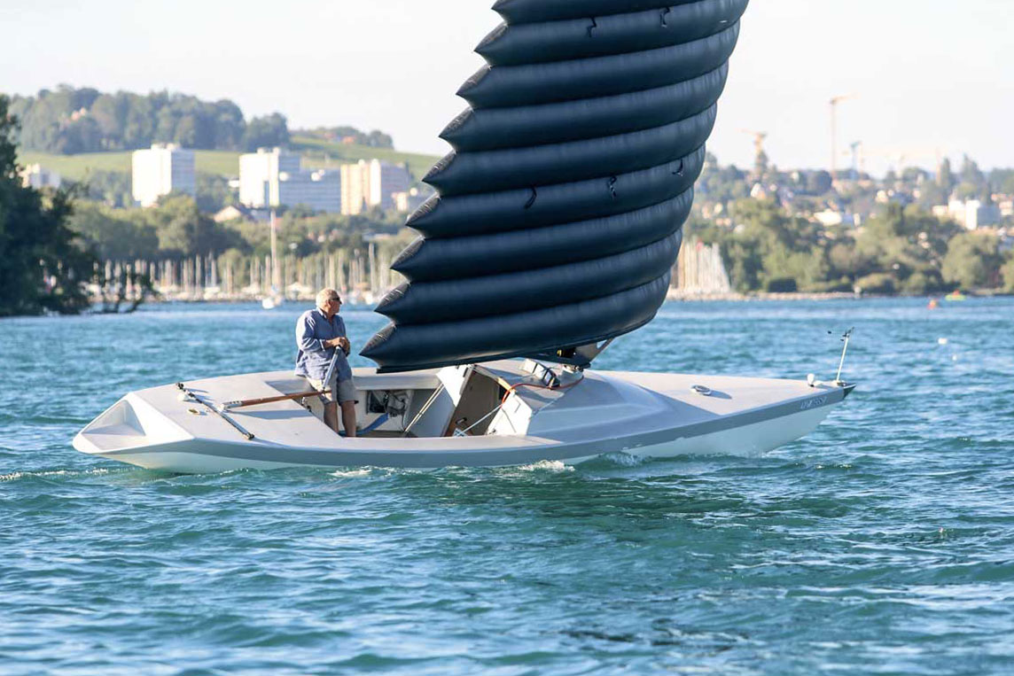
Some Recent Tech developments in yacht design
Foiling
Coming to a cruiser near us soon?
G4 by Holland composites
G4 by Holland composites
REDUCES EFFORT ON THE BOAT:
Shape control using the internal pressure
no battens
no local stress
better aging
The wing flies vertically and does not create local stress inside the membrane (light sail cloth used for both ribs and the fairing)
Little heel angle upwind
Perfect for gigantic sails such as superyachts
Free-standing, retractable and light mast hidden inside the wing
Less leeway control needed, lighter keel and boat reinforcements
A refined deck free of any hardware
Seen these? IWS –Inflated wing sail
IWS Wing sail video

Slide 4
A quick word on NMEA 0183 vs NMEA 2000 (because connectivity is king!)
NMEA 0183 Disadvantages | NMEA 0183 Advantages | NMEA 2000 Disadvantages | NMEA 2000 Advantages
Serial connection (RS232 or RS422), ‘1 to 1 connection method’ requiring multiplexers and buffers to connect multiple devices together. Slow and uni-directional. | (Conversion gateways are available (to allow older NMEA0183 kit to work on an NMEA2000 network.) | Difficult to Debug without specialized equipment. Interoperability between vendors still not perfect. | Controller area network (Canbus) powered backbone. Simultaneous ‘talkers’ and ‘listeners’
Low data transfer rate, originally 4800 baud, but AIS drove requirement for 38400 baud (for signals with only two possible states one baud = 1 bit/second) |  | Still insufficient for complex data eg: Video/Cartography…higher data demands mostly replaced with Cat 5 ethernet | 50 x faster than NMEA0183
 |  | Significant problems with backbone result in all connected devices stopping working! | Nearly endless data sharing
 |  | (Think about redundancy/backup connections/options!)

Slide 5
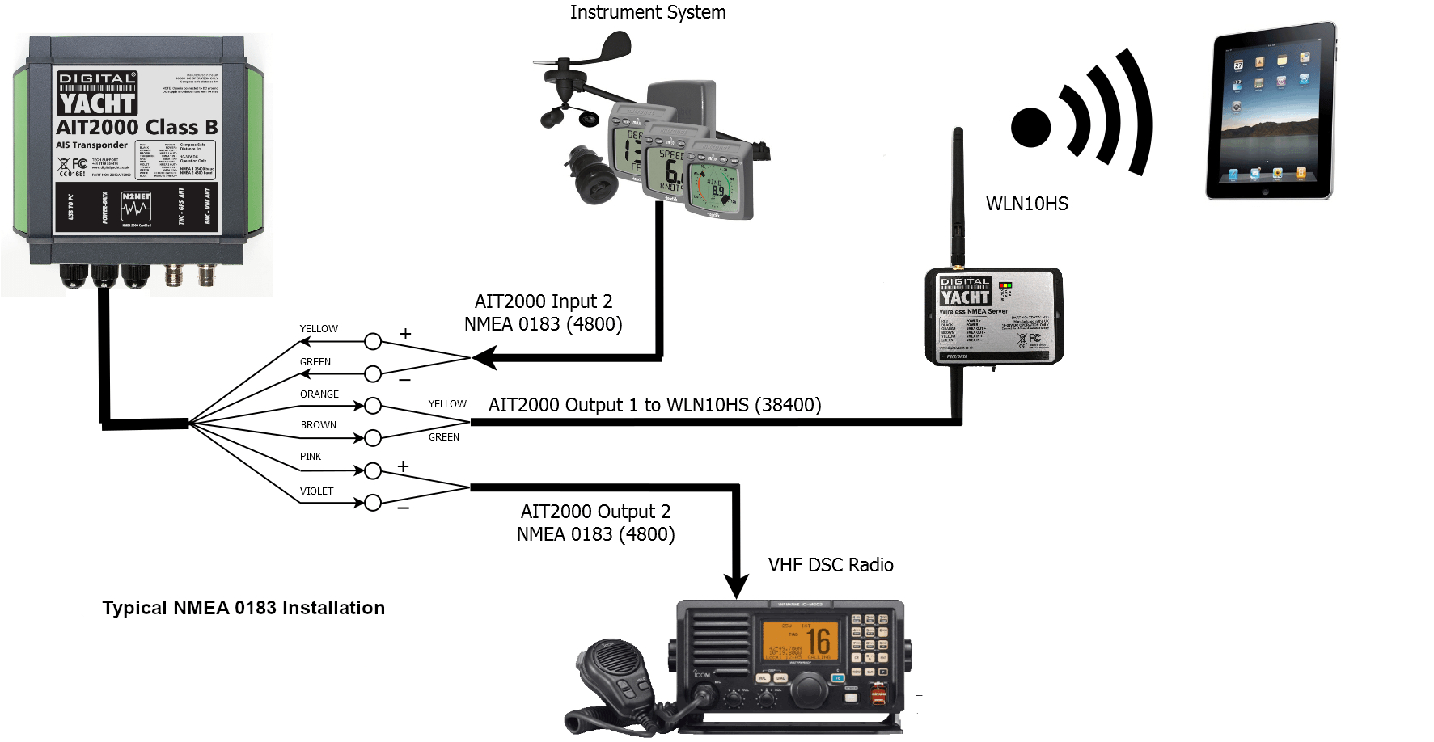
NMEA 0183
NMEA 2000

Slide 6
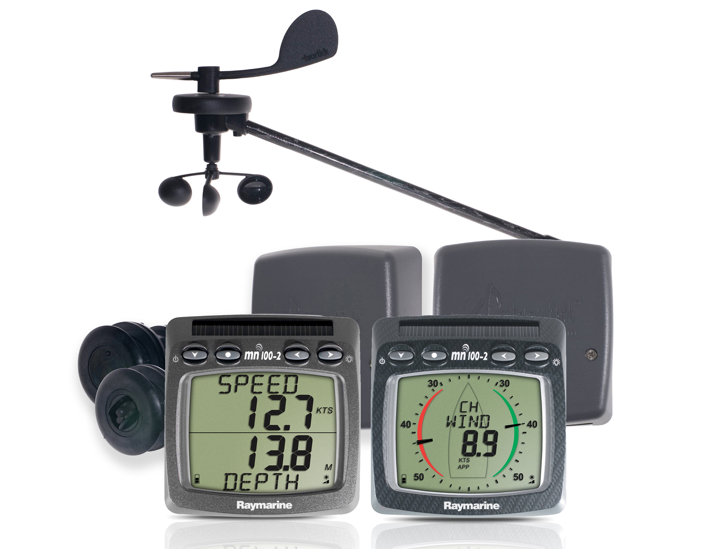
…or go Wireless?

Slide 7
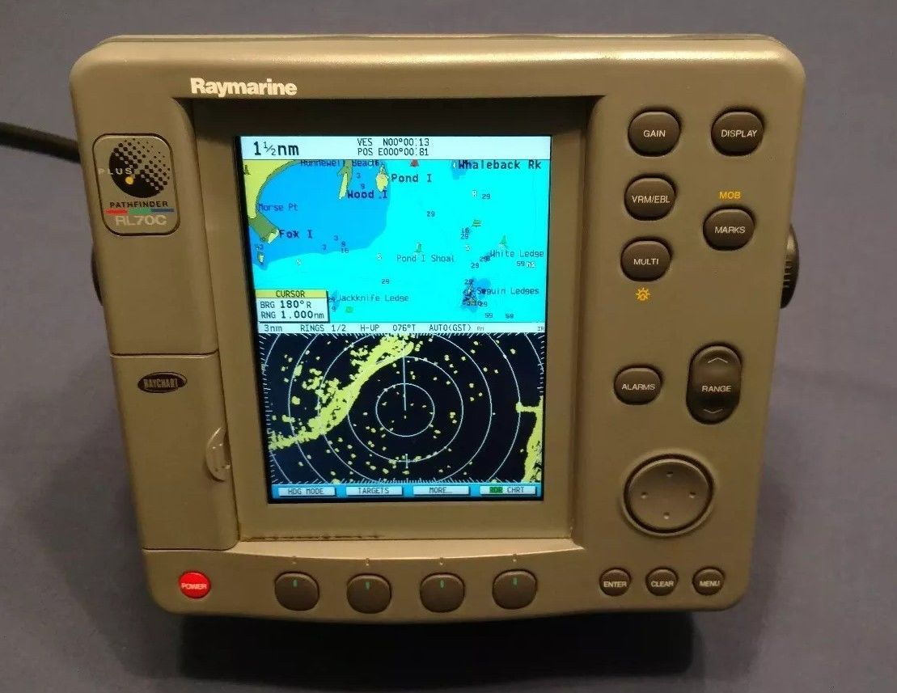
New tech Solid state Dopler radar (no magnetron) with target analyzer
Progress with radar…
Old tech
AIS solutions also often now have similar target threat intelligence.

Slide 8
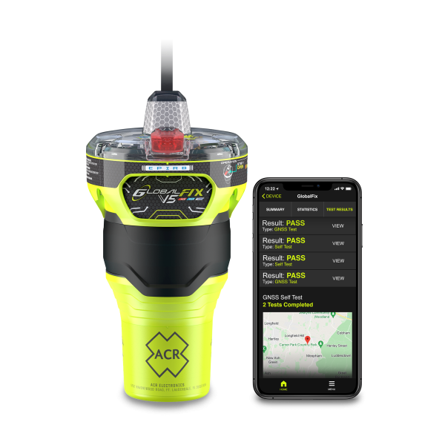
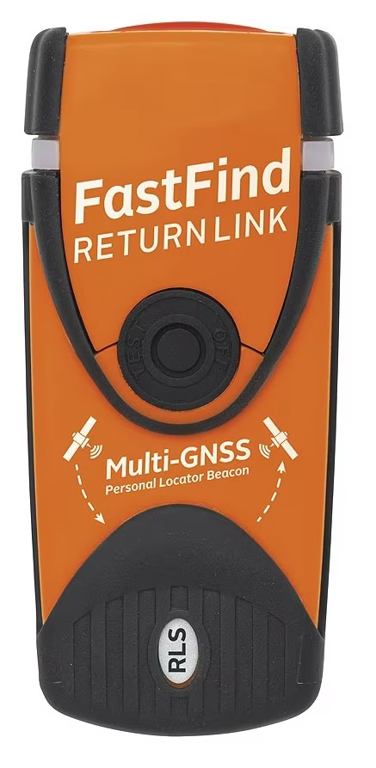
An assortment of recent Tech developments in boat electronics
Expected battery life 72 hours+, typically ship mounted or in ‘Grab’ bag
Newer design Emergency position indicator radio beacons (EPIRBS) and Personal locator Beacons (PLB’s) now have ‘ReturnLink’ acknowledgement built-in.
A visual acknowledgement that your distress signal has been received by the authorities.
Expected battery life 24 hours, typically person mounted

Slide 9
New design AIS/DSC MOB beacons
sMRT SHIELD+
Automatically water-activated
Dual GNSS (ie: GPS/Gallileo)
5 year battery life, minimum 12 hour reporting period.
seamlessly integrates 406 MHz, AIS, and VHF DSC technologies, ensuring comprehensive alerting and tracking capabilities
Sends a position indicating distress message to nearby AIS receivers/transponders AND your own nearby VHF DSC radio on board your boat/nearby boats.
Typically mounted in lifejacket

Slide 10
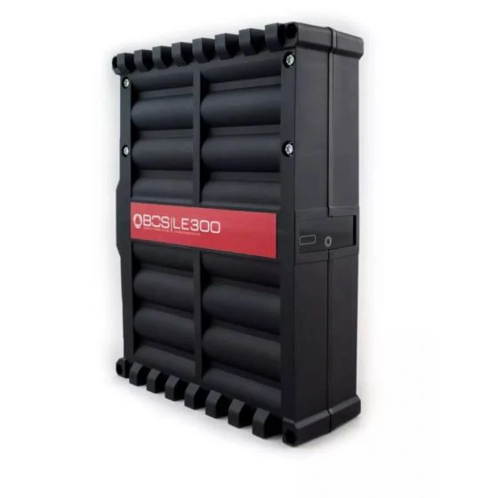
Recent developments in battery technology
We’re presumably all now familiar with Lithium or LifePO4, but how about these small lightweight ‘adjunct’ lithium units?
Manufacturer video

Slide 11
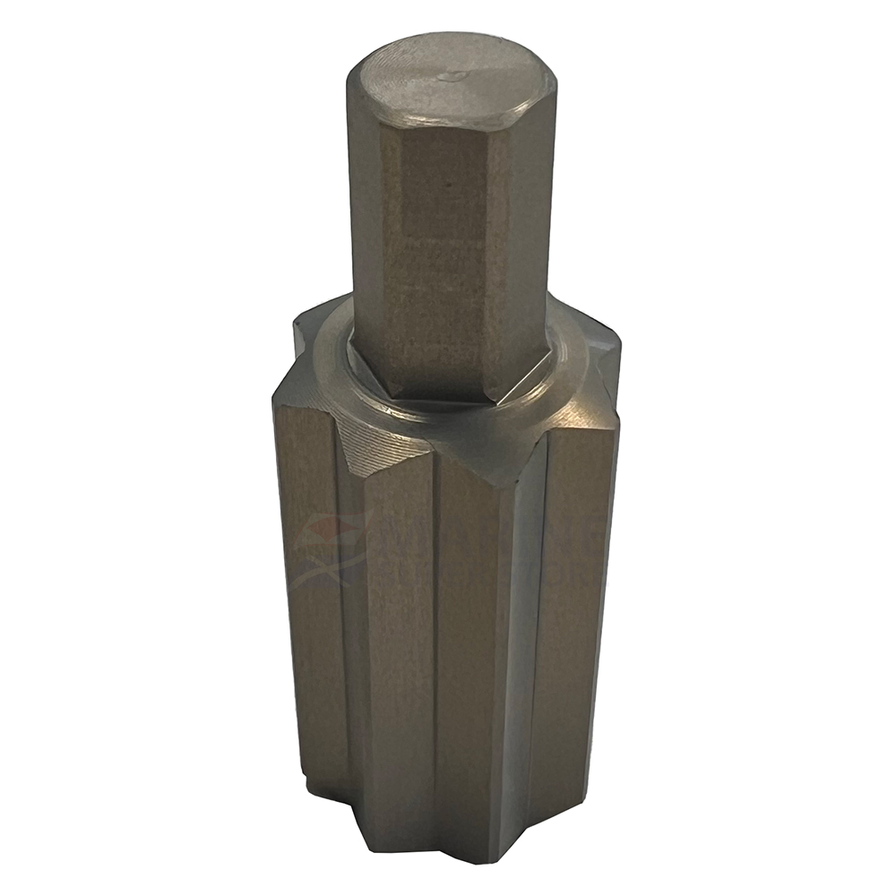
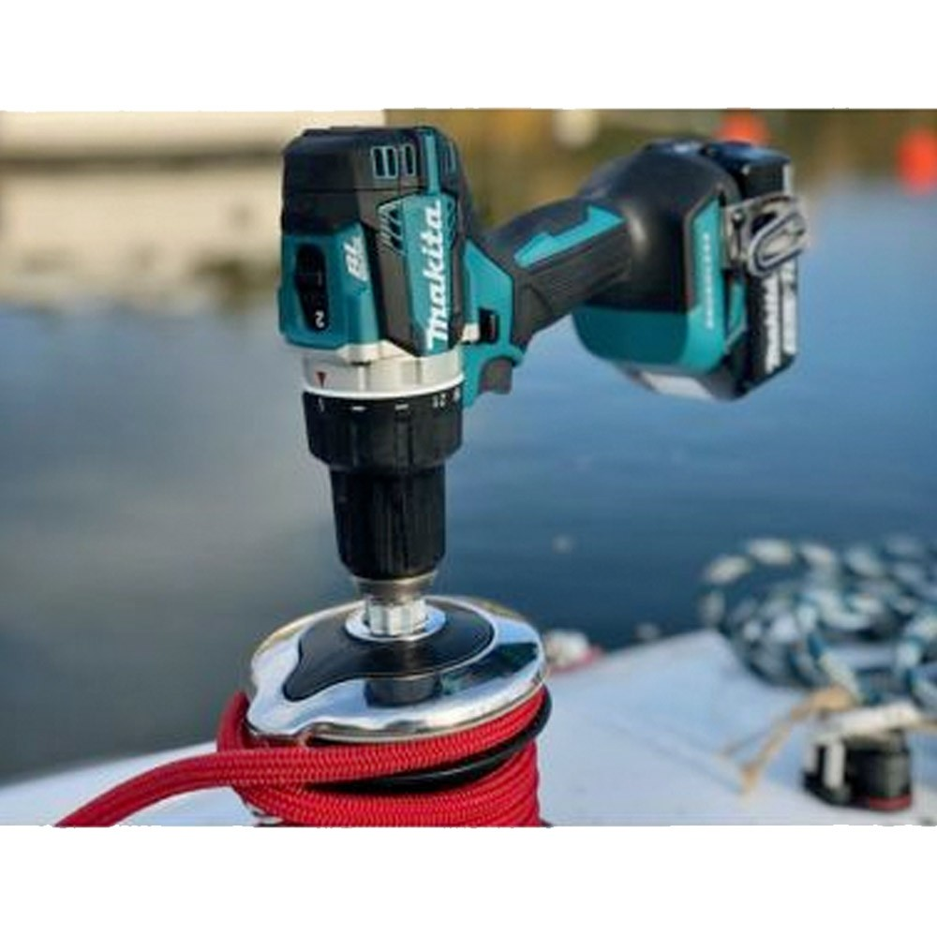
iWinch bit
A budget friendly way to upgrade your winches
iWinch video

Slide 12
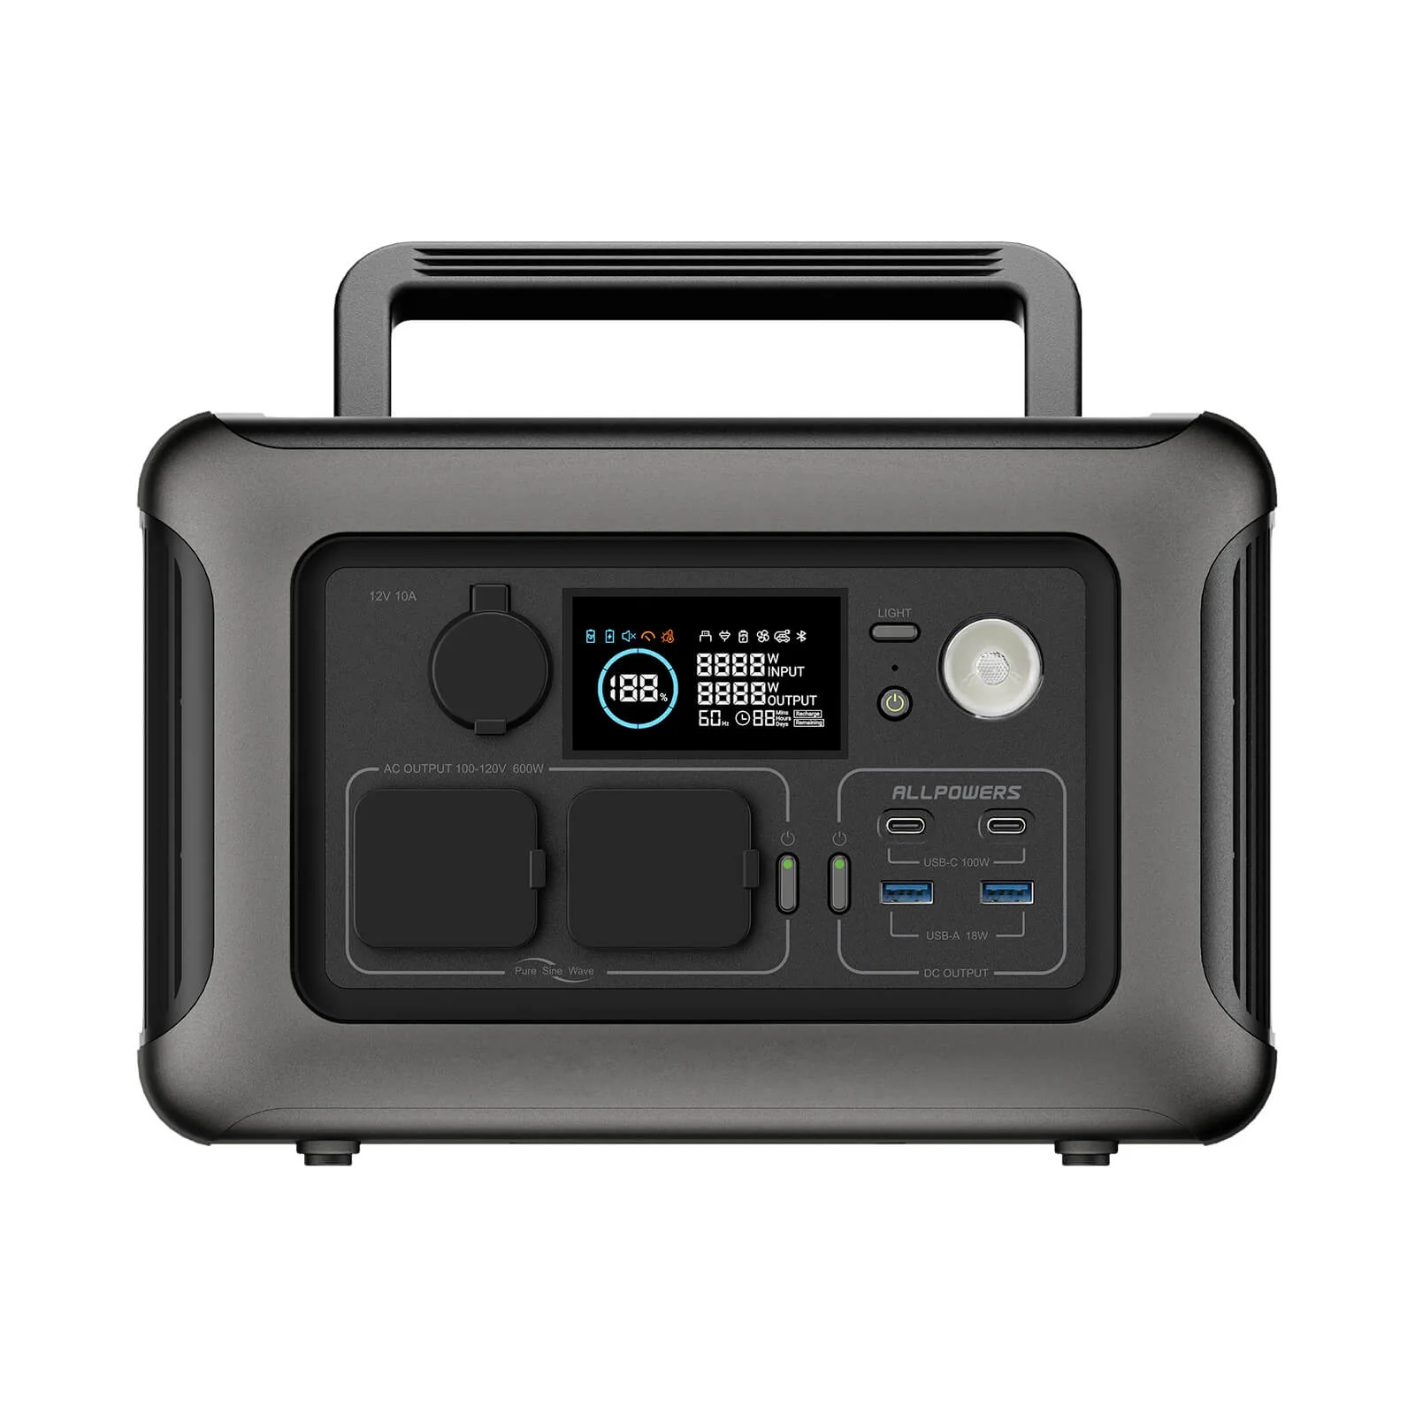
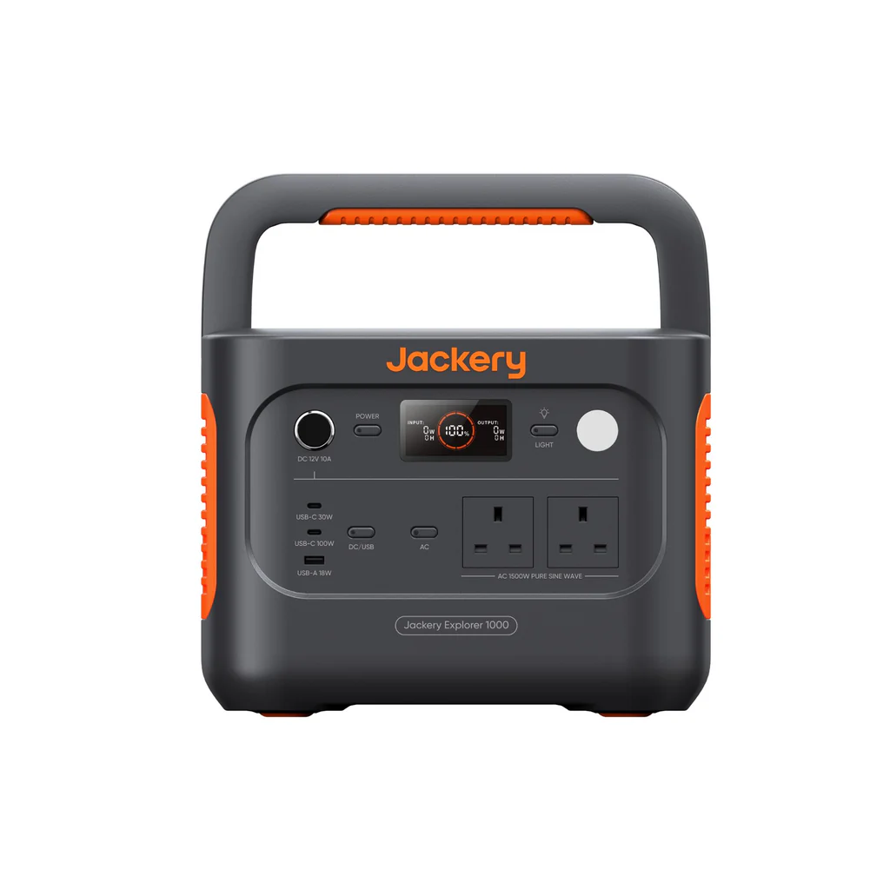
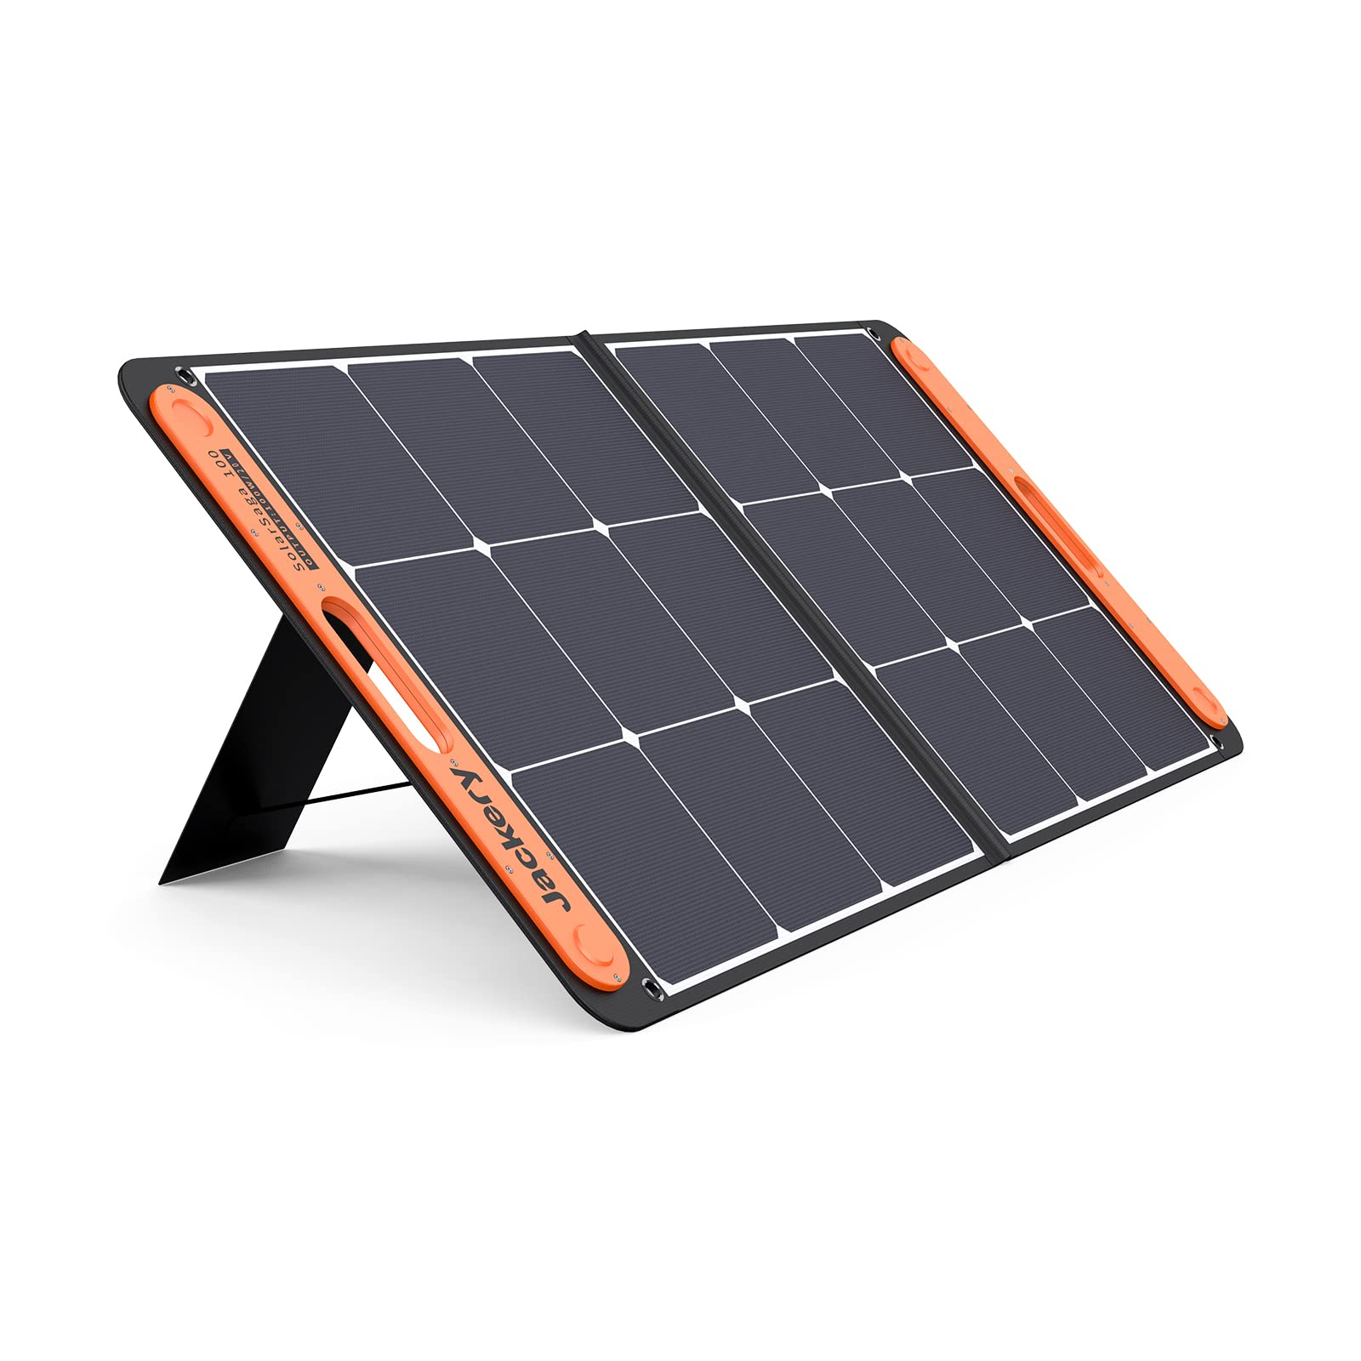
An easy way to get independent Mains power on board?
Portable power stations
Essentially portable lithium batteries with in-built inverters
Various wattage outputs available
Charge them up when solar or shorepower is available, utilise them when it isn’t.

Slide 13
Some Recent Tech developments in other boat accessories
Fire safety sticks
A, B, C, F & Electrical fires
- 50 Seconds Discharge Time
- Light & Compact, No Damaging Residue, No Mess
Independent test

Slide 14
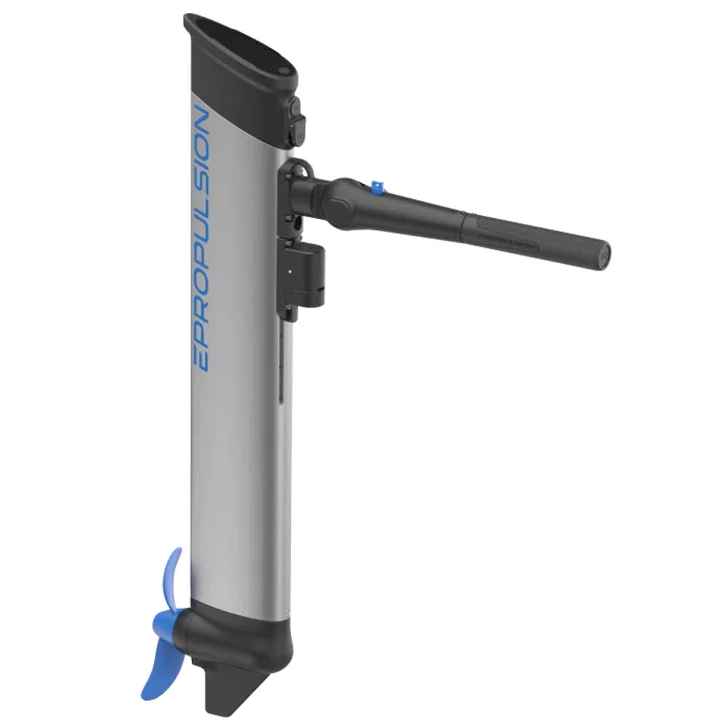
Some Recent Tech developments in other boat accessories
E-Propulsion E-lite electric outboard motor
1.5 Hp equivalent, 378 Wh integrated lithium battery, 6.7Kg (14.7llbs) weight, excluding transom bracket. Compact 297 x 75 x 890 mm
Upto 1.5 hours runtime (half throttle)
Manufacturer link
Influencer link
POWER (W) | SPEED (MPH/KPH) | RUNTIME (HH:MM) | RANGE (MILE/KM)
Half Power 250W | 3.7 / 6.0 | 1h 30m | 5.6 / 9.0
Full Power 500W | 4.7 / 7.5 | 45m | 3.5 / 5.6
Sport Mode 750W | 5.2 / 8.3 | ** | -

Slide 15
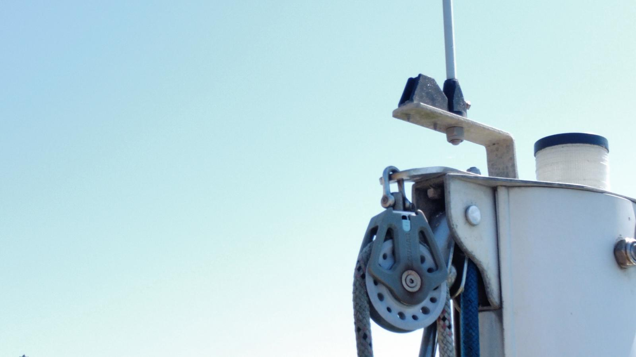
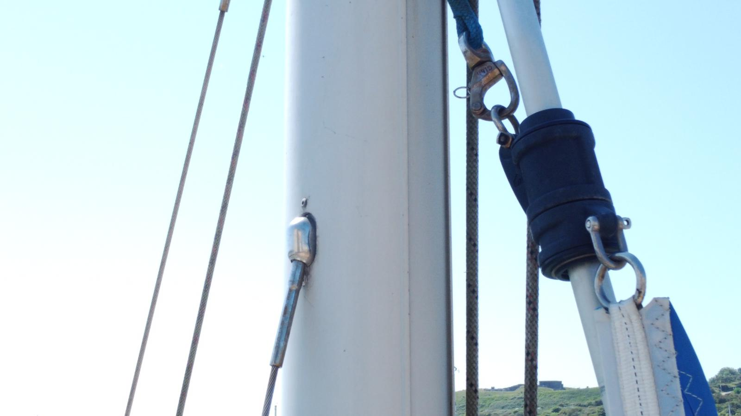
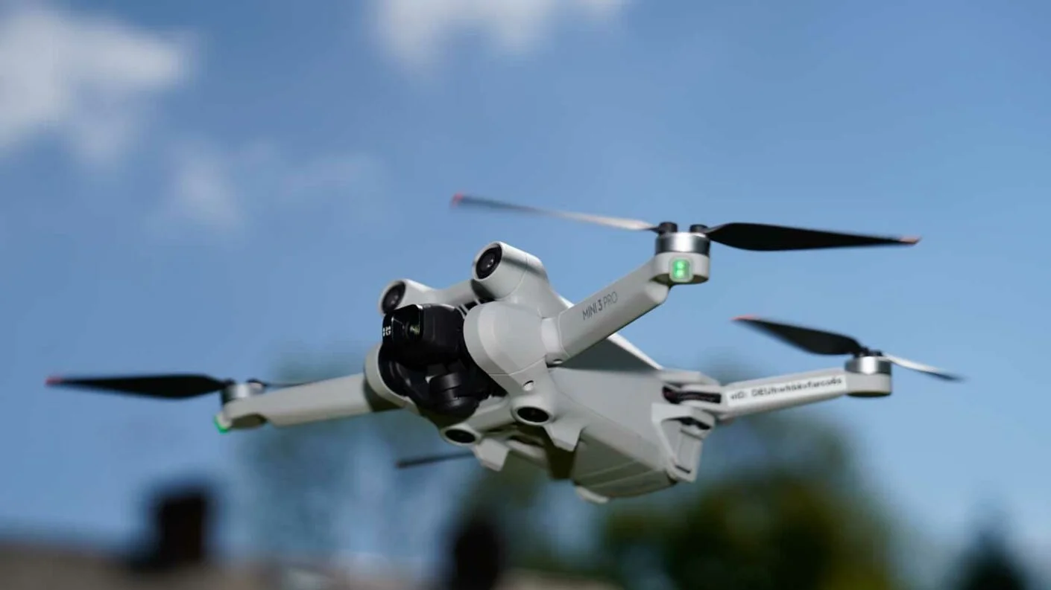
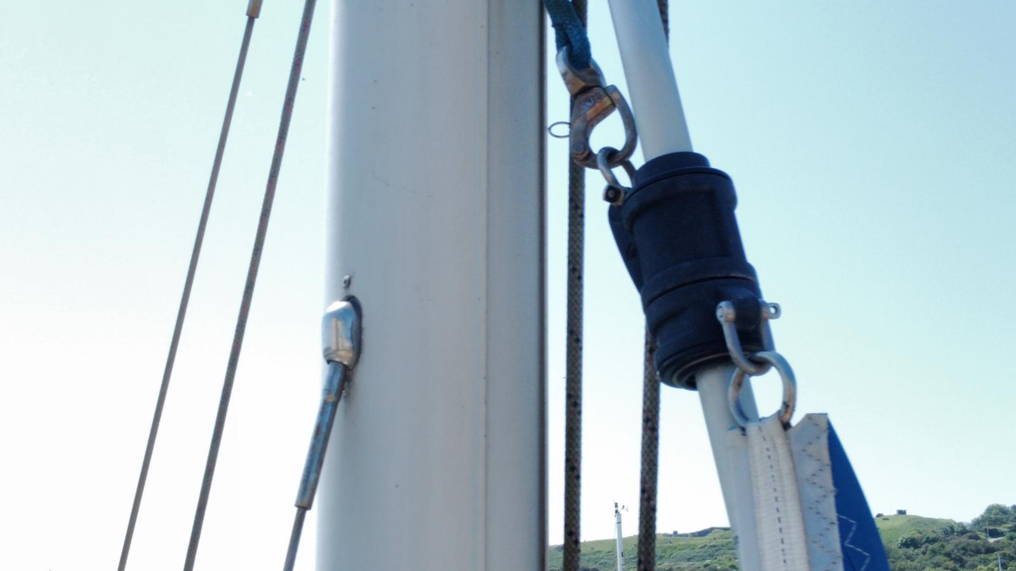
Boat ‘Hacks’
Rigging inspections from the safety of the cockpit?

Slide 16
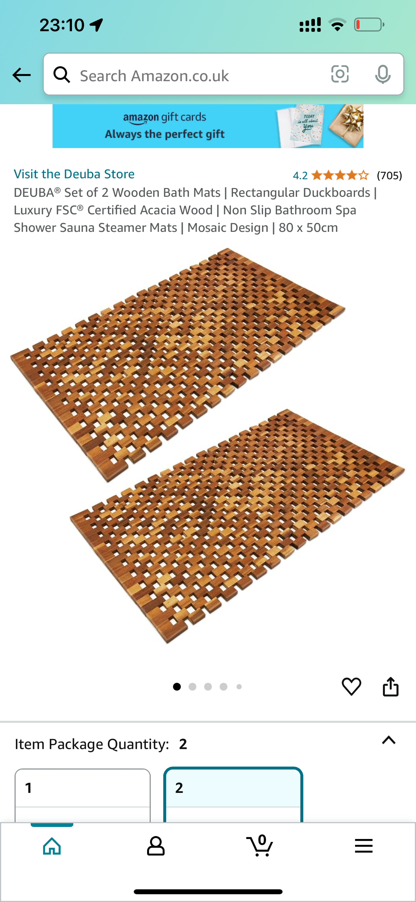
Boat ‘Hacks’
Roll-up cockpit flooring
Dirt catching
Comfort in hot environments
Floor protection
Link

Slide 17
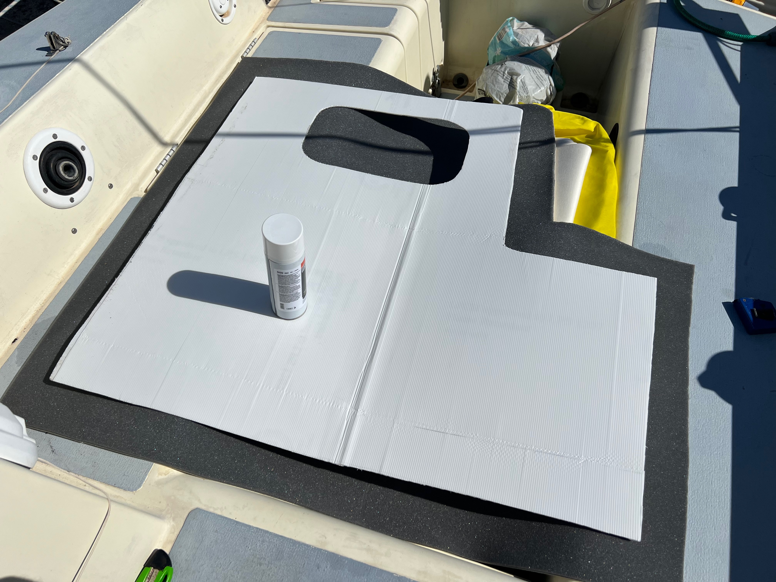
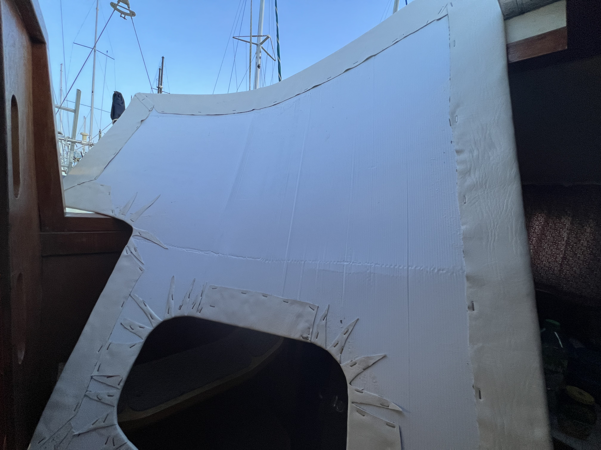
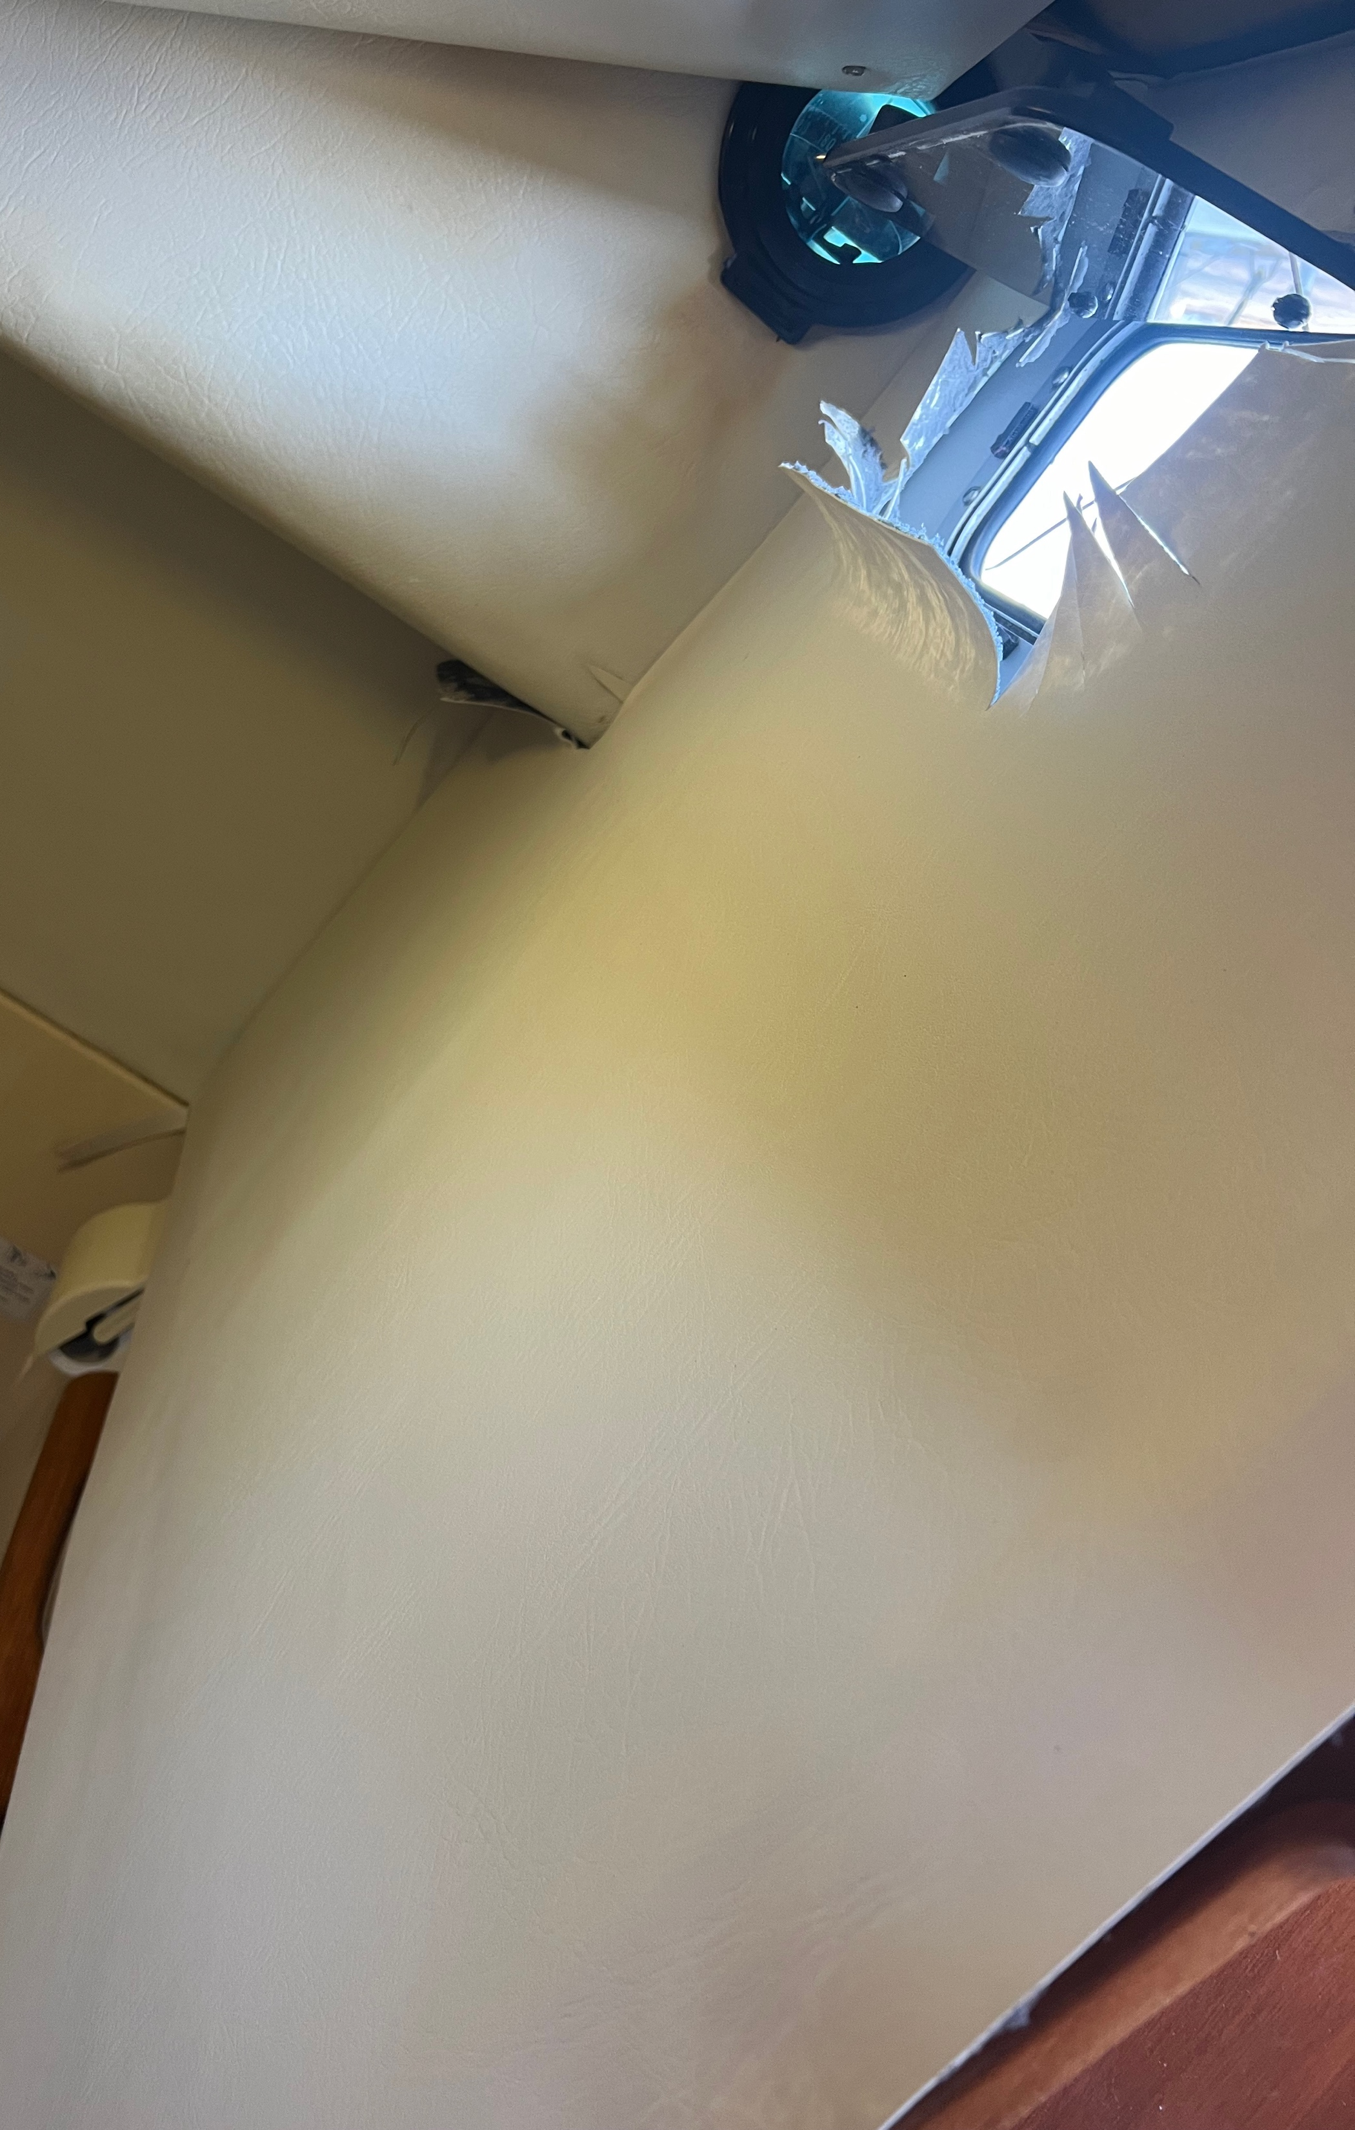
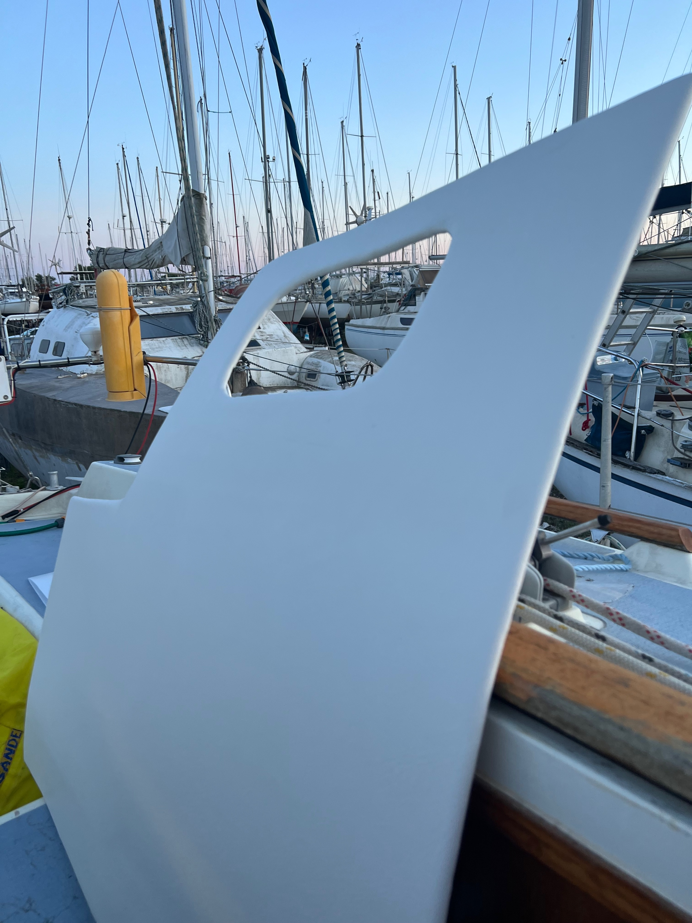
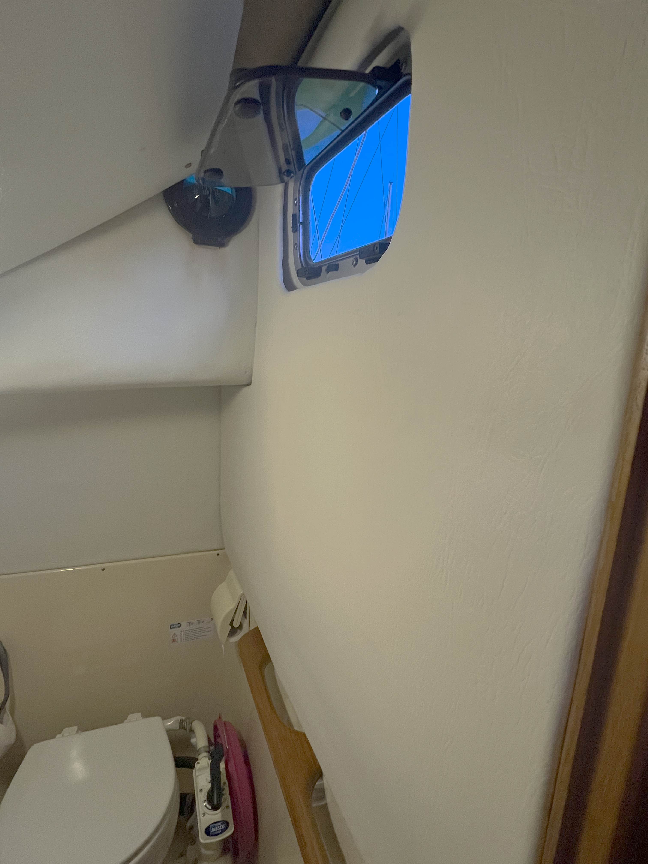
Boat ‘Hacks’
Dealing with‘Westerly droop’
Corex headlining panels

Slide 18
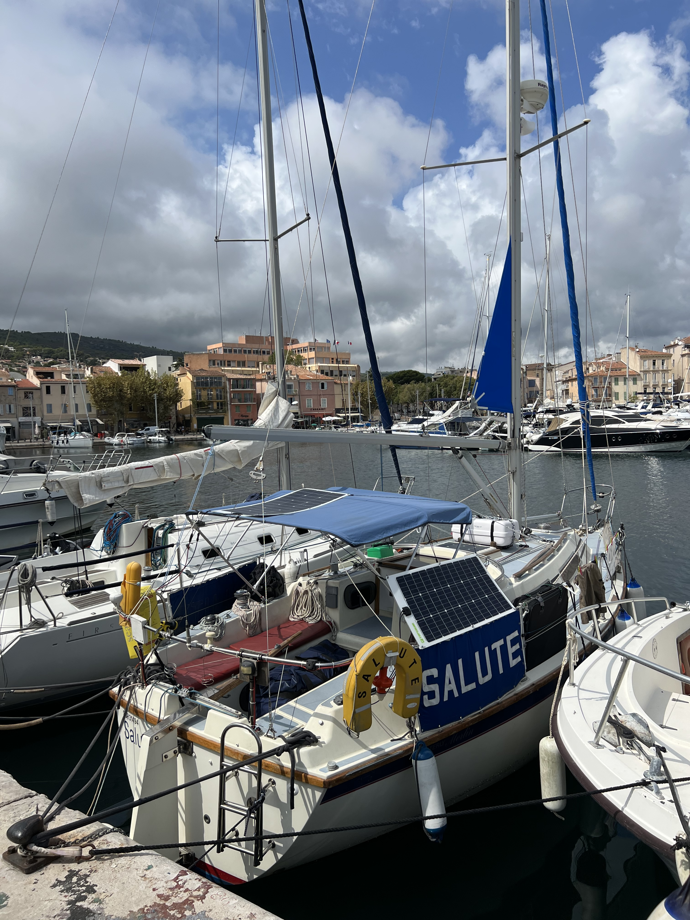
Boat ‘Hacks’
Solar panel ‘tricks’
Strategic dynema cord placement means solar panel can be routed to 3 positions very quickly and easily.
Notes:
18

Slide 19
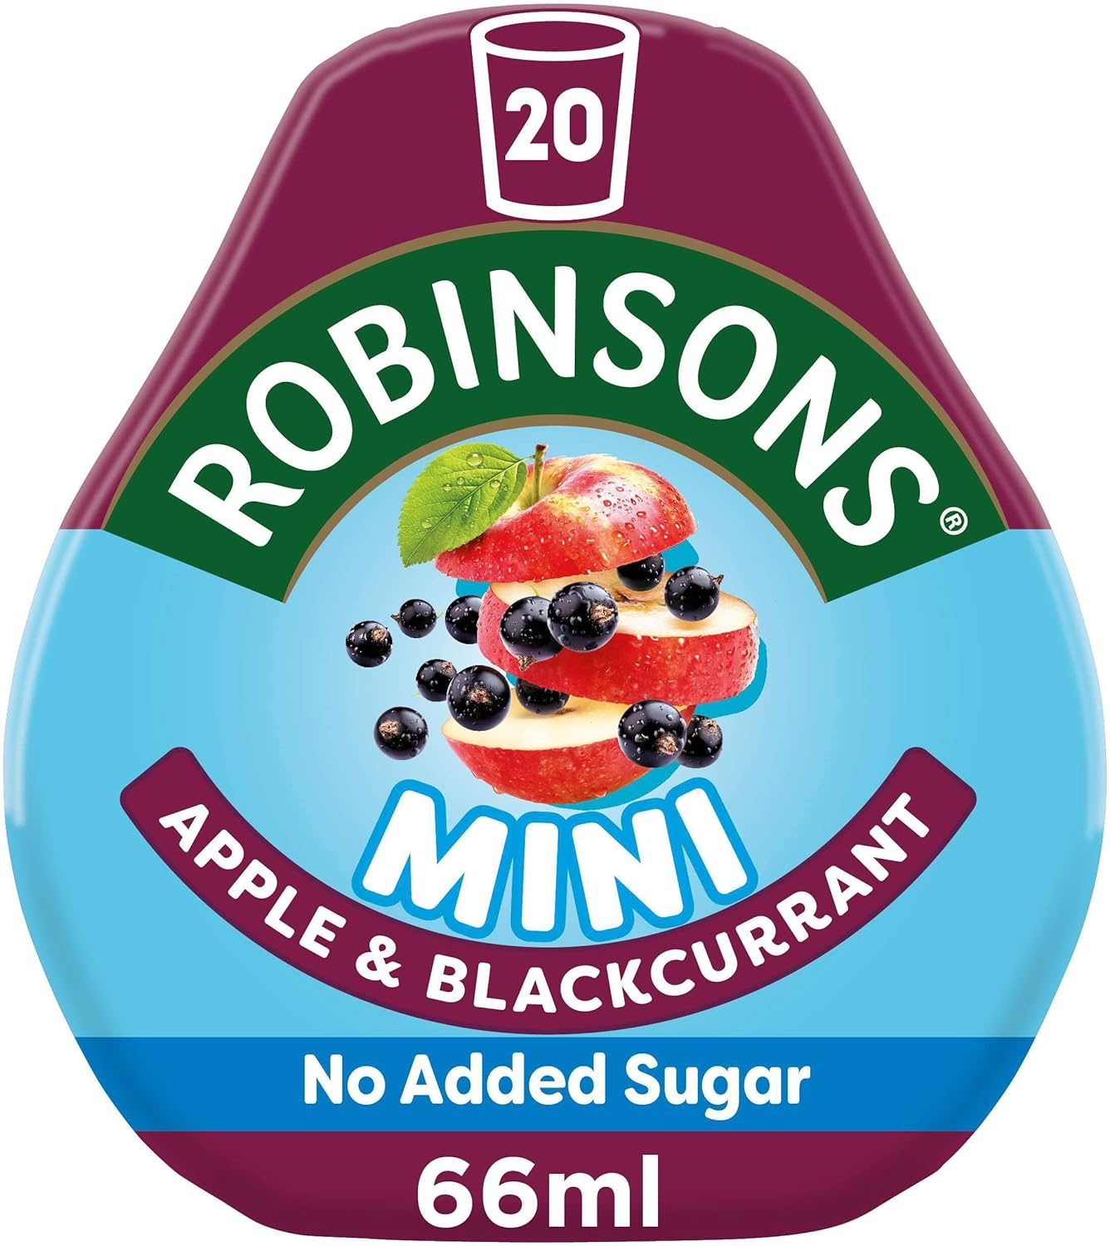
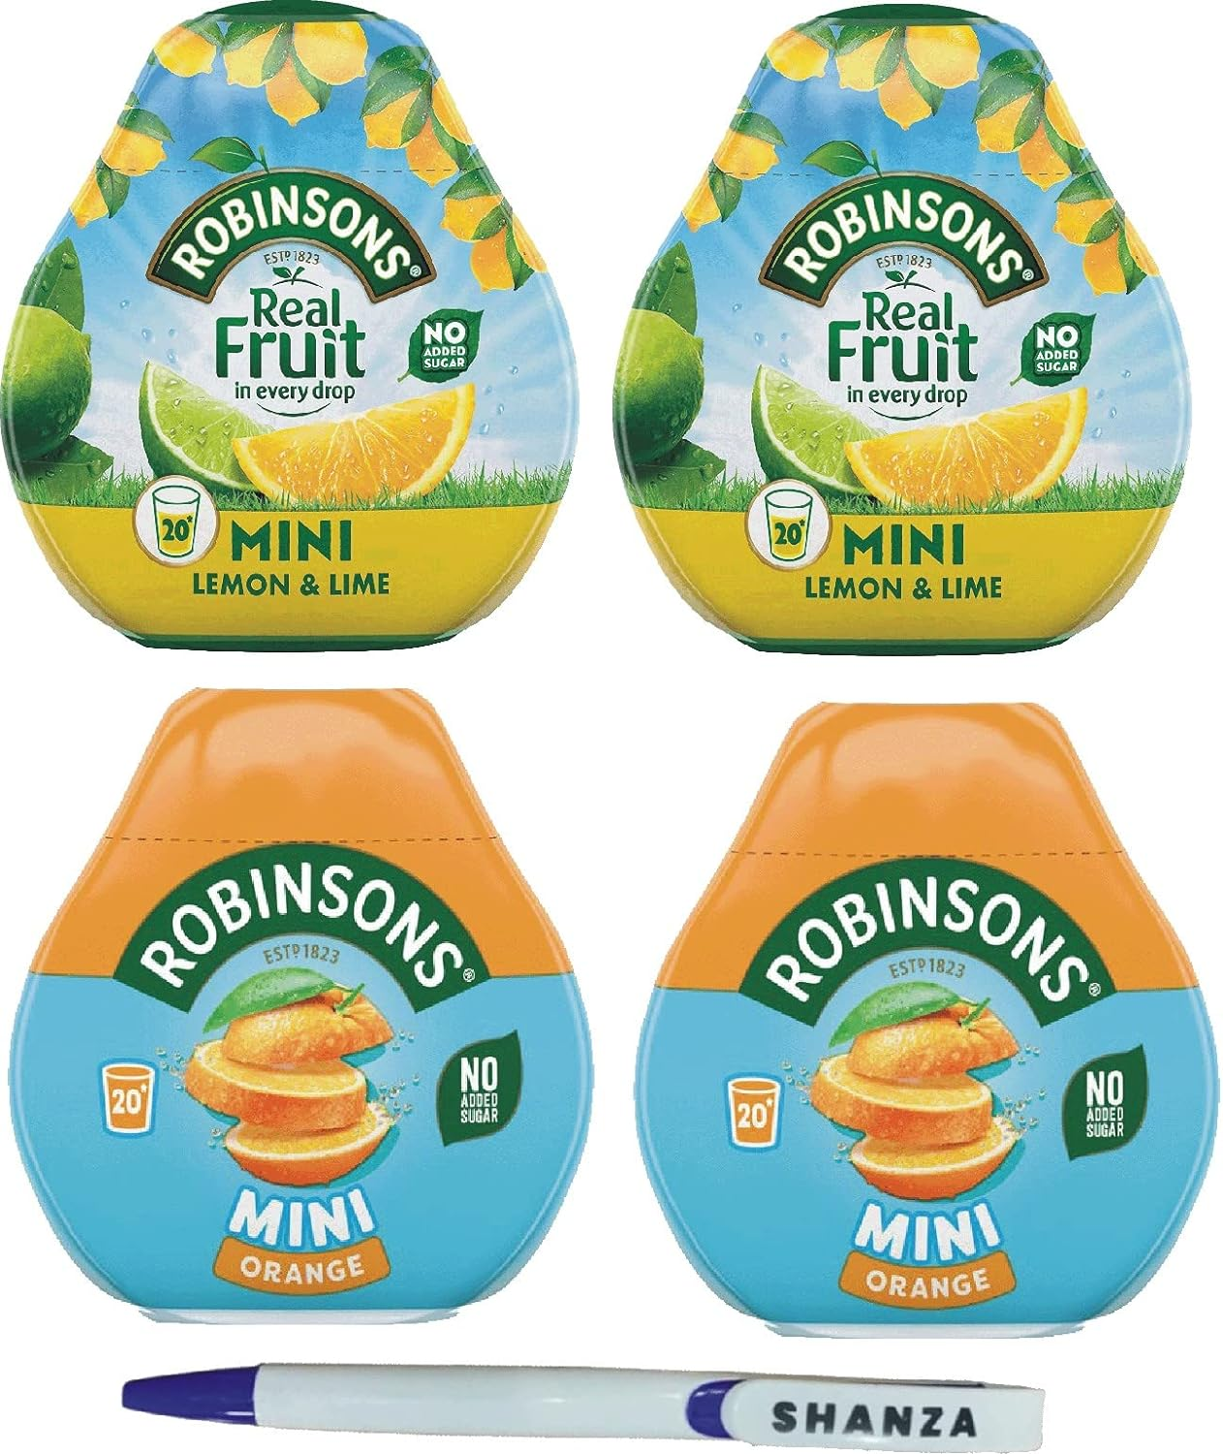
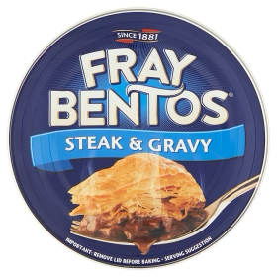
Boat ‘Hacks’
Refreshment and sustenance underway

Slide 20
Discussion
…and now your own improvements / ‘Hacks’?
Notes:
20

